Slide 1

BUG BUSTERS
Group 8
Taiwo Ojo
Mengjia Yu
Roxy Caicedo
Jorge Cuautle

Slide 2


Database Structure
👑
🫡
👤
ADMIN
admin_id, name, email, password
STAFF
user_id, name, email, password
USER
user_id, name, email, password
🐛
BUGS
bug_id, ticket_number, bug_name, source_application, severity, impact,
RATINGS
rating_id, bug_id, user_id, rating
COMMENTS
comment_id, bug_id, user_type, comment, approved, created_at
Notes:
ENABLES STUDY… TESTS… DISCOVERIES IN… WITHSTANDS…
(matter/antimatter asymmetry)

Slide 3
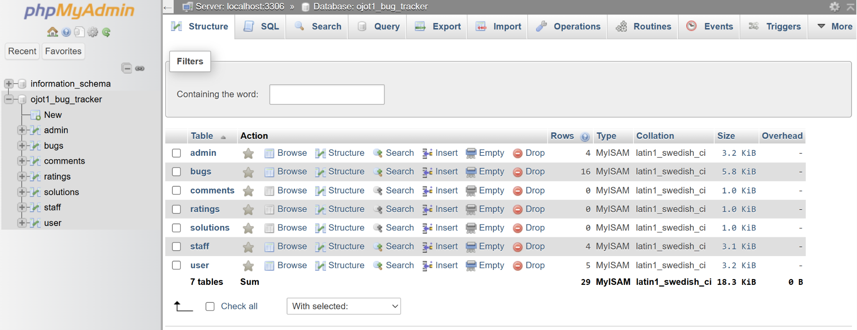
Backend Database

Slide 4
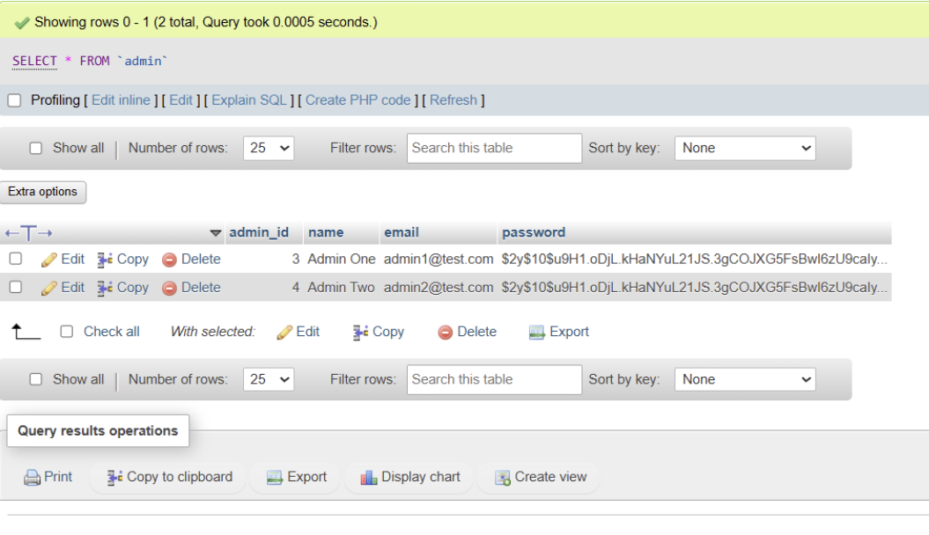
Backend Database

Slide 5
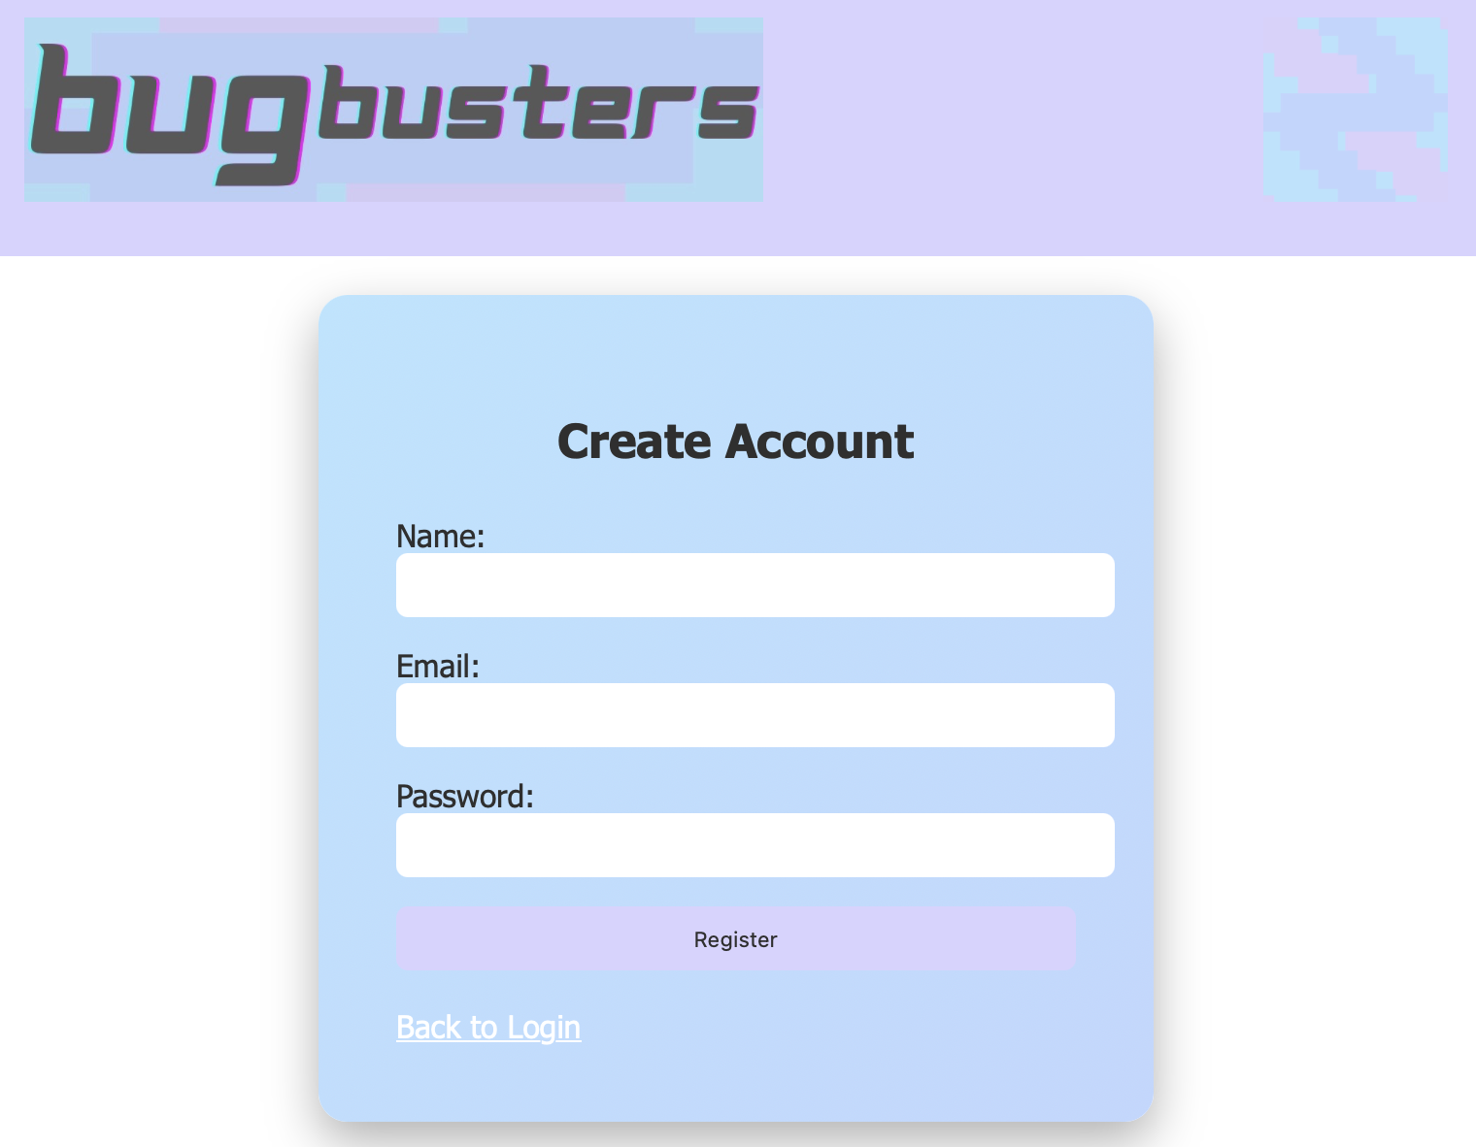

Register and login

Slide 6
Roles, Permissions, & Access
ADMIN
Login to system
Add/Edit staff members
Assin new bugs to staff members
Approve/Reject solutions
Submit and view comments on bugs
STAFF
Login to system
View assigned bugs
Submit bug solutions
Submit and view comments on bugs
USER
Login to system
Submit a new bug
Submit and view comments on bugs
Rate their resolved bugs

Slide 7
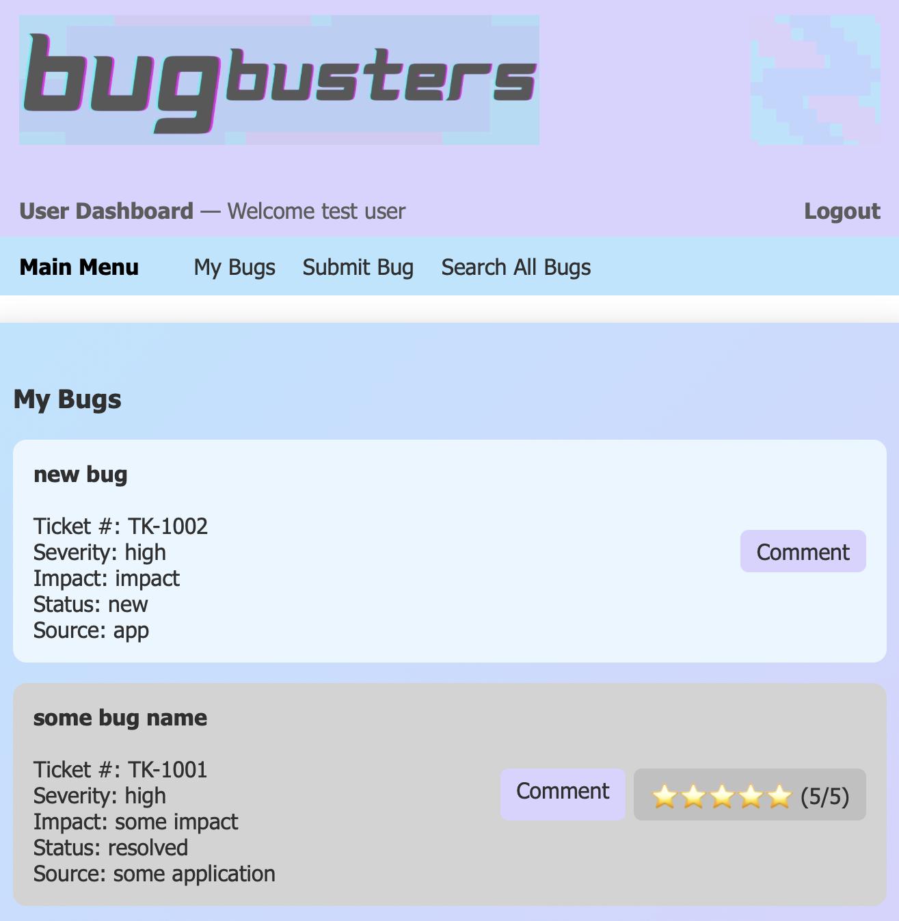
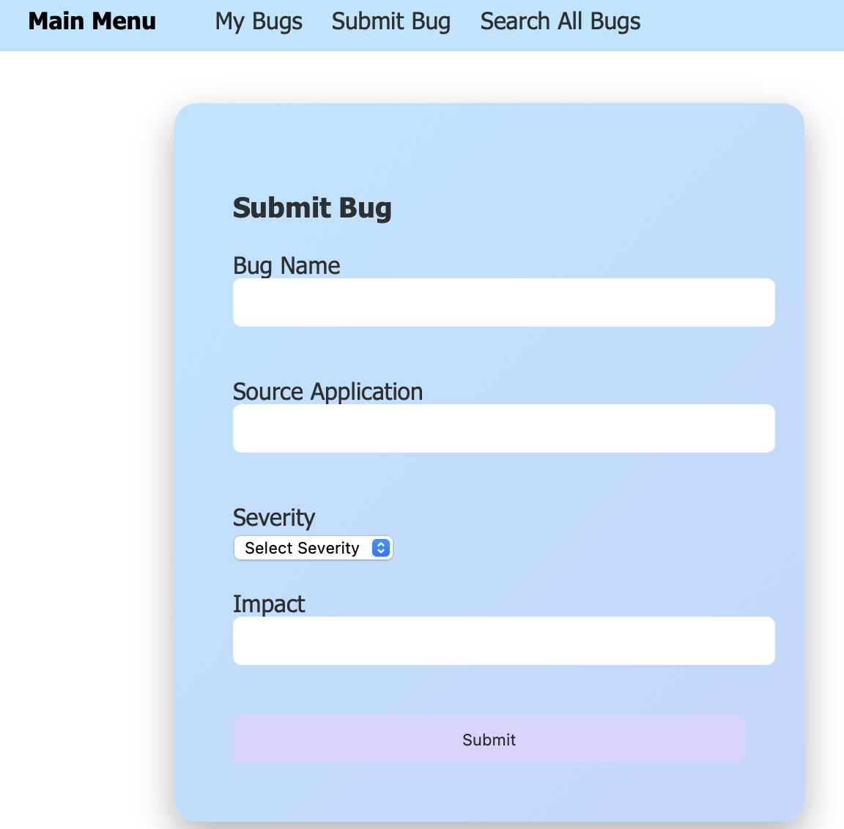
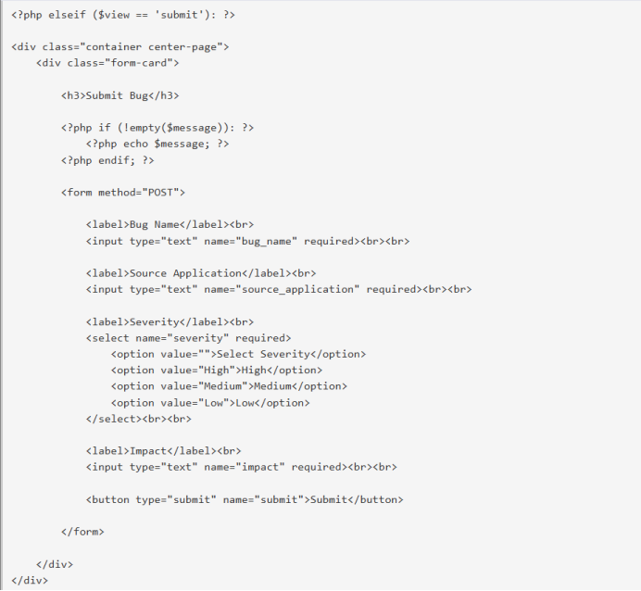
Role based home pages - User

Slide 8
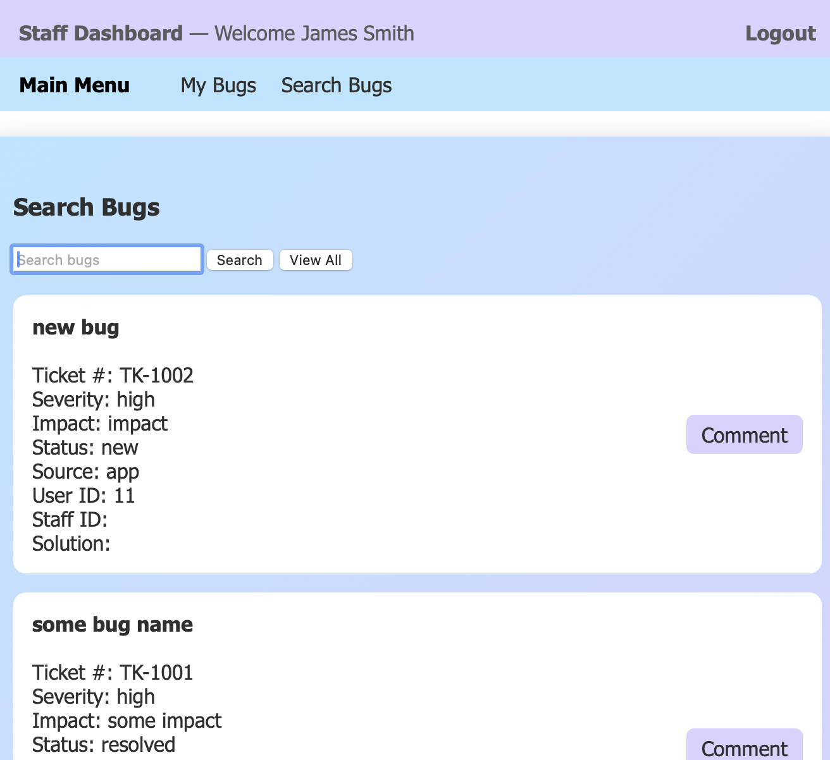
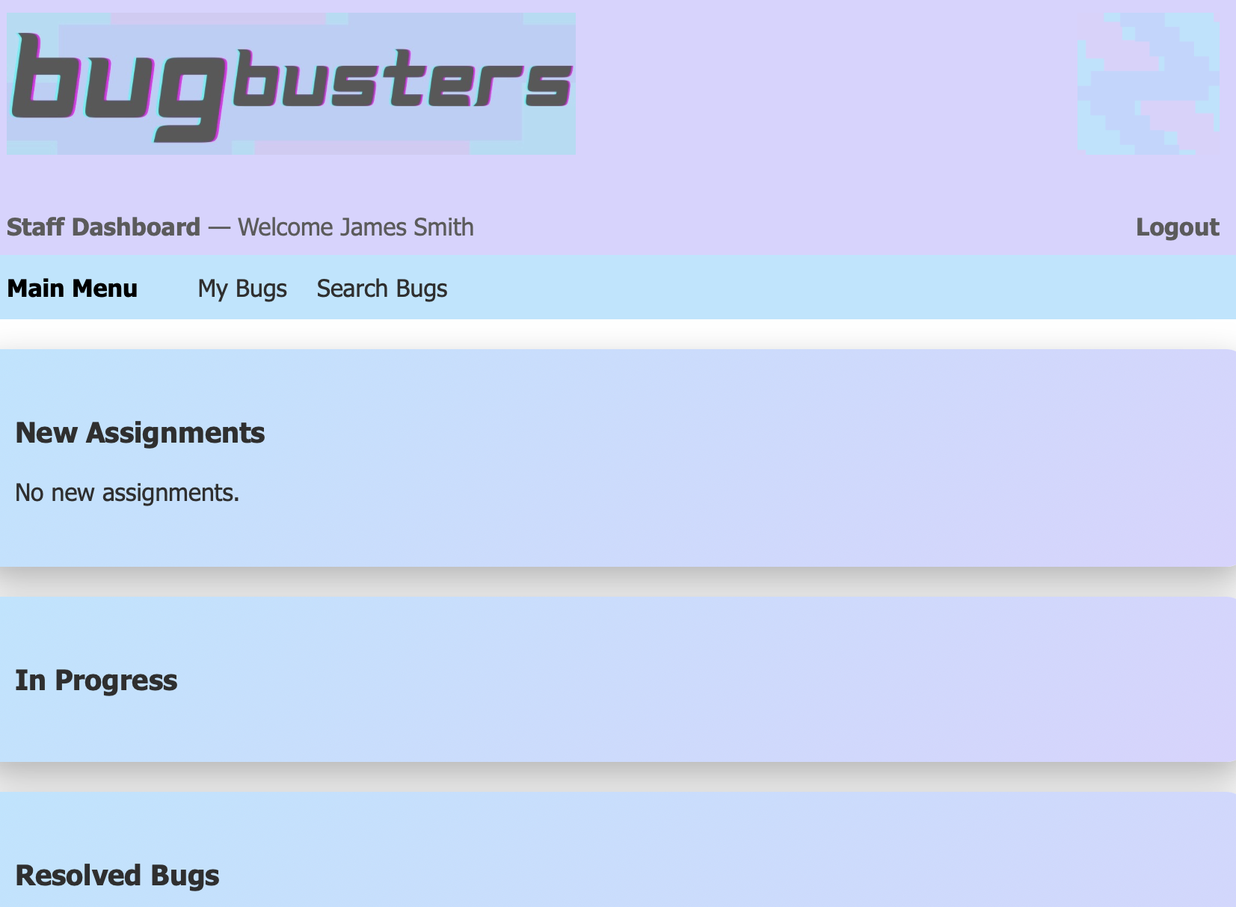
Role based home pages - Staff

Slide 9
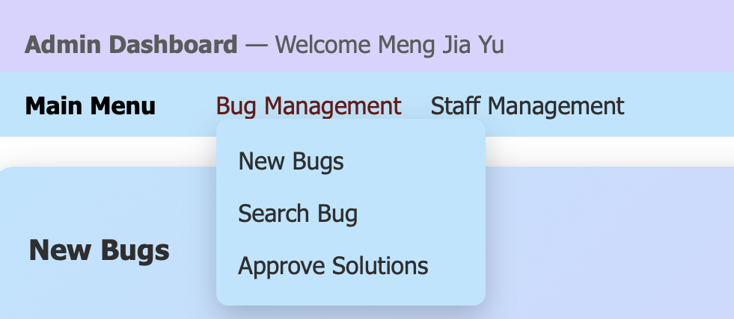
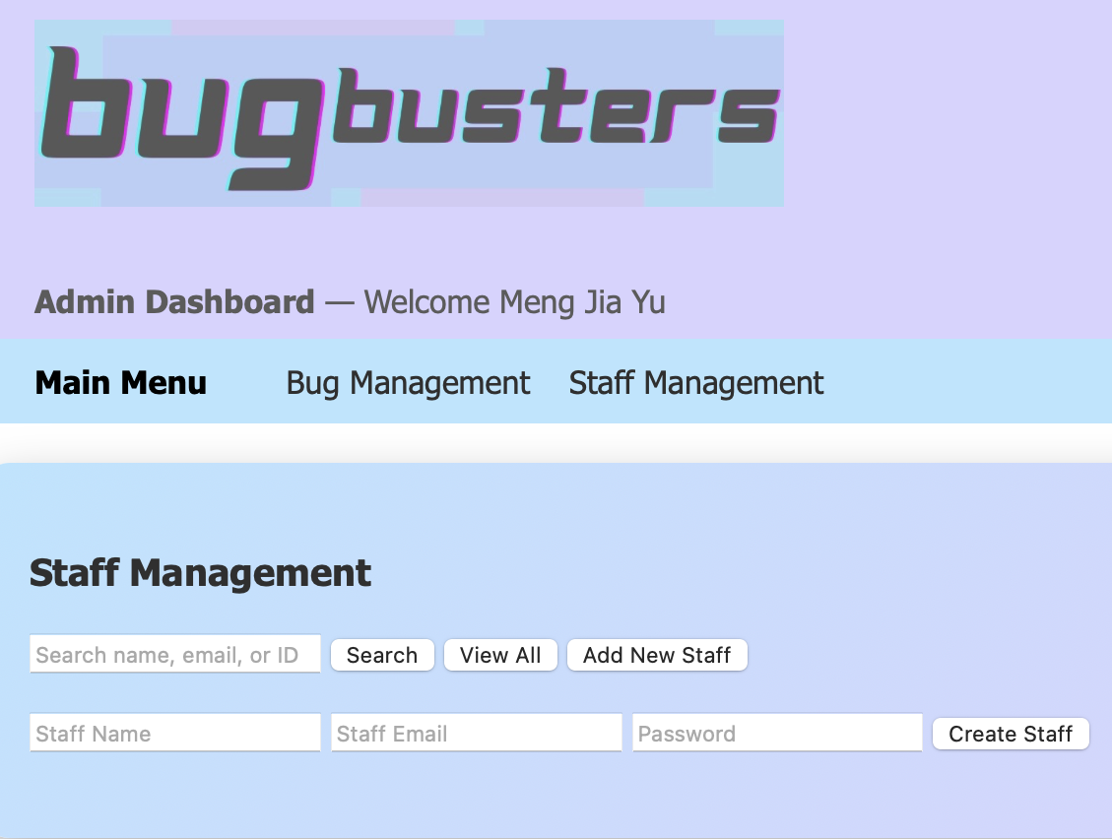
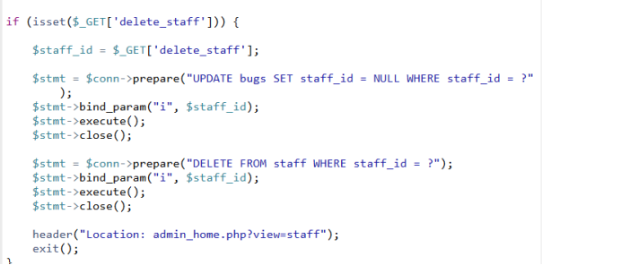
Role based home pages - Admin

Slide 10
CSS Styling + inline styling
Global styling is used throughout our Bug tracker website with a single CSS file
Layout of headers, menus, and forms
Styling for forms, buttons, cards
Color scheme for visual consistency
#B7E5FF → baby blue
#BFD7FF → lavender
#D8D3FF → light pink
#2F2F2F → dark gray
Key features:
form card {login/register}
menu bar {role navigation}
section card {dashboard sections + overall design}
assign card {smaller width + positioning}
Inline color styling of bugs based on status on user and staff home pages (dynamic value)

Slide 11
A Bug’s Life
Submission to Resolution
Bug Status:
New
Assigned
In Progress
Pending Approval
Resolved
User submits their bug
User submits a bug using the form with required fields: title, severity, impact, and source application
Admin assigns the bug to a staff member
Admin reviews the new bug, makes any necessary edits and assigns the bug to a staff member
Staff accepts
bug assigned
Staff member sees the bug in new assignments and accepts the assignment updating its status to in progress
Staff submits bug solution
Staff member works on a solution to the bug and submits their solution. It is send to admins for approval
Admin
approves the bug
Admin reviews the bug solution. They can approve or reject it. If rejected, it goes back to the staff as assigned. If approved, status is updated to resolved
User rates the bug solution
The bug status is updated to resolved and the user can rate the resolution with a star rating from 1-5
Notes:
HTML + PHP
HTML : Forms, submit buttons PHP : POST, GET, SQL queries, transitions between stages using STATUS
GET for actions (approve/reject)
isset($_POST) for form submissions
Uses prepared statements to prevent SQL injection
SQL queries update db
STATUS field controls where bugs appear in the workflow

Slide 12
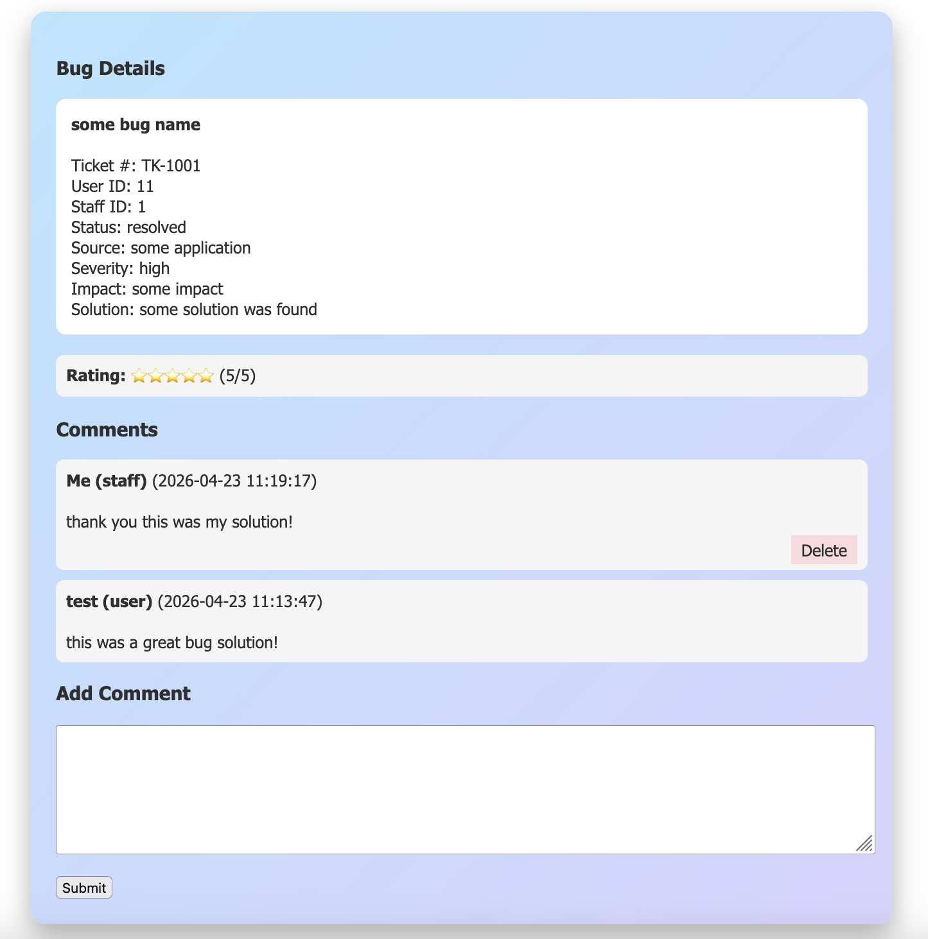
Comments
Comments are stored in DB comment table fields:
bug_id
user_type
user_id
comment
Staff Solutions also stored in same comments table
Comments handle regular comments and bug solution
Deleting comment, SQL query checks comment_id, user_id, & user_type so only user can delete their own comments
Notes:
Production Target
Primary beam at FRIB will be focused into a 1 mm diameter beam spot size on target
Power deposited in target ~ 100 kW
Power density at beam spot ~ 20–60 MW/cm³
Utilizes rotating multi-slice graphite target design to increase radiating area and reduced total power per slice
Dipoles vertically bend beam and create the spatial separation needed to weed out contaminants from fragments of interest
Quadrupoles used to focus beam
Magnetic Dipoles and Quadrupoles are superferric and either radiation-tolerant or radiation-resistant
To maximize efficiency, Front-end Quadrupoles utilize warm iron design
Return yoke & pole tip pieces are not cooled to cryogenic temperatures
Minimizes cooling power required to dissipate power absorbed from neutron and proton radiation
(Enclosed in 3 large vacuum vessels with shielded lids)
Down-stream Quadrupole Triplets utilizes cold iron design
Much weaker radiation fields
Return yoke & pole tip pieces cooled to cryogenic temperatures *heloium
(Enclosed in cryostat)
Wedge Energy Degrader
Creates mass separation in pre-separator
Compresses momentum distribution of RNB of interest

Slide 13

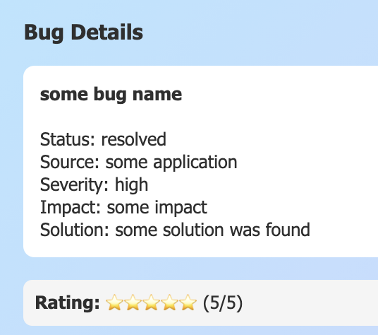
Ratings
Ratings are stored in DB ratings table fields:
rating_id
bug_id
user_id
rating
Rating Scale
1(Very Poor) - 5 (Exellent)
Only user can only submit rating

Slide 14
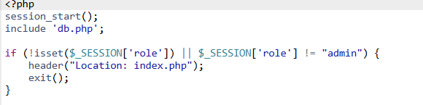
Security
Hashing’s Signifiance
Plain text passwords convert into a scrambled, irreversible string that cannot be read or reversed.
Role-Based Access Control
Every PHP page checks with $SESSION[‘role’] at the very beginning. If role does not match it redirects you to index.php. Along with an admin_guard.php for protection in admin pages
Save Password
$hashed = password_hash($password. PASSWORD_DEFAULT)
Verifying at Login
password_verify($password, $row[‘password’]);
Notes:
Production Target
Primary beam at FRIB will be focused into a 1 mm diameter beam spot size on target
Power deposited in target ~ 100 kW
Power density at beam spot ~ 20–60 MW/cm³
Utilizes rotating multi-slice graphite target design to increase radiating area and reduced total power per slice
Dipoles vertically bend beam and create the spatial separation needed to weed out contaminants from fragments of interest
Quadrupoles used to focus beam
Magnetic Dipoles and Quadrupoles are superferric and either radiation-tolerant or radiation-resistant
To maximize efficiency, Front-end Quadrupoles utilize warm iron design
Return yoke & pole tip pieces are not cooled to cryogenic temperatures
Minimizes cooling power required to dissipate power absorbed from neutron and proton radiation
(Enclosed in 3 large vacuum vessels with shielded lids)
Down-stream Quadrupole Triplets utilizes cold iron design
Much weaker radiation fields
Return yoke & pole tip pieces cooled to cryogenic temperatures *heloium
(Enclosed in cryostat)
Wedge Energy Degrader
Creates mass separation in pre-separator
Compresses momentum distribution of RNB of interest

Slide 15
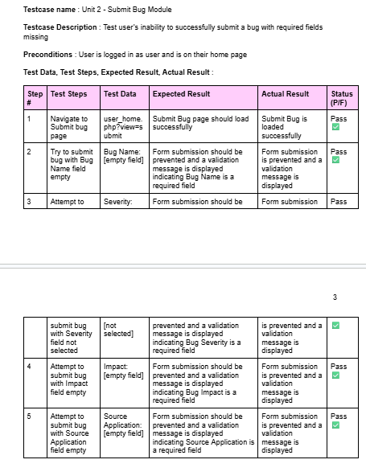
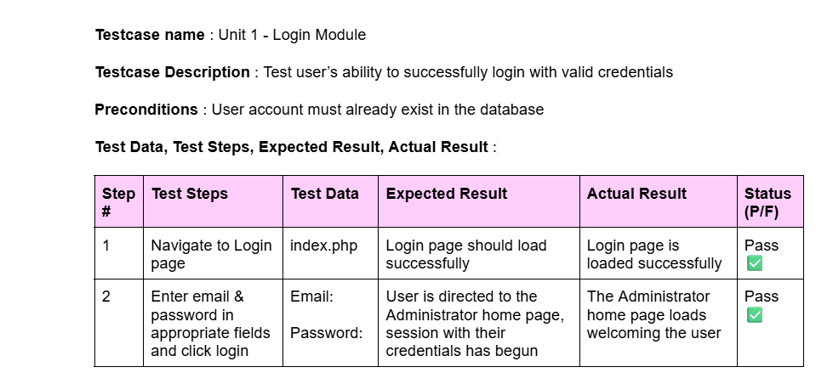

Slide 16
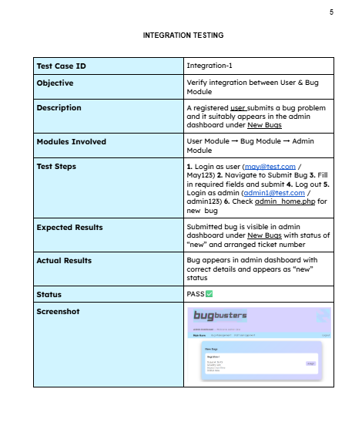
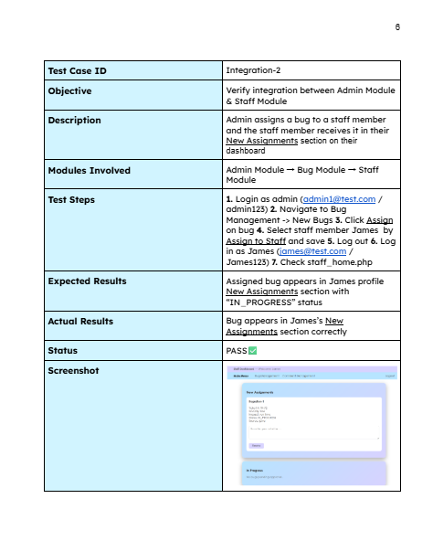

Slide 17
Project Challenges
Each member had limited experience with SQL, PHP HTML :: alot of time in the beginning was spent learning so start or project was delayed
Time Conflict :: once we really had a handle on what we wanted to do and how to do it there was limited time left
Schedule Conflict :: we had trouble meeting in person together, but we solved this by dividing and layering the work

Slide 18
THANK YOU

Slide 19
Some slides we made but didn’t end up using in the presentation…

Slide 20
Overview
WEB-BASED
***
Bugbusters is a web-based bug tracker that allows clients to submit bugs, staff to resolve bugs, and administrators to manage the workflow
PURPOSE
***
Our purpose was to provide a transparent, user-friendly system for bug submission, tracking, management and resolution
APPLICATIONS
***
Frontend:
PHP, HTML, CSS
Backend:
MySQL Database
Notes:
Overall Achromatic
2 consecutive 30° dipole magnets
A dispersive image is formed at the beam dump position after the first 30° dipole magnet w/ resolving power 700 - first momentum acceptance set with slits here at beam dump
The second 30° dipole magnet adds to that resolving power so that after refocusing a dispersive image w/ resolving power 1720 is formed - second momentum acceptance set here at the wedge
→ high resolving power reduces the background and allows single ions to be unambiguously identified
Thicker energy degraders used to increase the mass separation lead to an increased production of contaminants from secondary reactions in the degrader. The multi-stage layout of ARIS suppresses these secondary reaction products & enchanes yield purity
The downstream section forms the achromatic image at the entrance to the second separator stage.
Ions of different mass to charge (m/z) ratios are deflected to a different extent, resulting in a ‘sorting’ of ions by mass
(virtually all ions have charges of z = +1, so sorting by the mass to charge ratio is the same thing as sorting by mass). A detector at the end of the curved flight tube records and quantifies the sorted ions.
The mass spectrometer is able to separate and detect ions of slightly different masses and then to distinguish the different isotopes of a given element

Slide 21
Key Features
LOGIN MODULE 🔐
ADMIN Login → Bug & Staff Management
STAFF Login → Bug Resolution
USER Login → Bug Submission & Rating
BUG MODULE 🐛
Submit bug with optimized property fields
Comments and ratings
Organized data flow of Bug life
Ticketed number system
SEARCH MODULE 🔍
Search bugs by keyword(s)
Universal role access to bug search module
Admin can search staff
RATING MODULE ⭐
1-to-5 star system
User rates their bug solution
All roles can view ratings of resolved bugs
Notes:
Overall Achromatic
2 consecutive 30° dipole magnets
A dispersive image is formed at the beam dump position after the first 30° dipole magnet w/ resolving power 700 - first momentum acceptance set with slits here at beam dump
The second 30° dipole magnet adds to that resolving power so that after refocusing a dispersive image w/ resolving power 1720 is formed - second momentum acceptance set here at the wedge
→ high resolving power reduces the background and allows single ions to be unambiguously identified
Thicker energy degraders used to increase the mass separation lead to an increased production of contaminants from secondary reactions in the degrader. The multi-stage layout of ARIS suppresses these secondary reaction products & enchanes yield purity
The downstream section forms the achromatic image at the entrance to the second separator stage.
Ions of different mass to charge (m/z) ratios are deflected to a different extent, resulting in a ‘sorting’ of ions by mass
(virtually all ions have charges of z = +1, so sorting by the mass to charge ratio is the same thing as sorting by mass). A detector at the end of the curved flight tube records and quantifies the sorted ions.
The mass spectrometer is able to separate and detect ions of slightly different masses and then to distinguish the different isotopes of a given element

